Slide 1

Breast Cancer
Data mining project

Slide 2
team members: Mostafa Mahmoud salah Mohamed Ahmed ramadan Abdallah farag Mohamed ramadan Mohamed Mahmoud

Slide 3
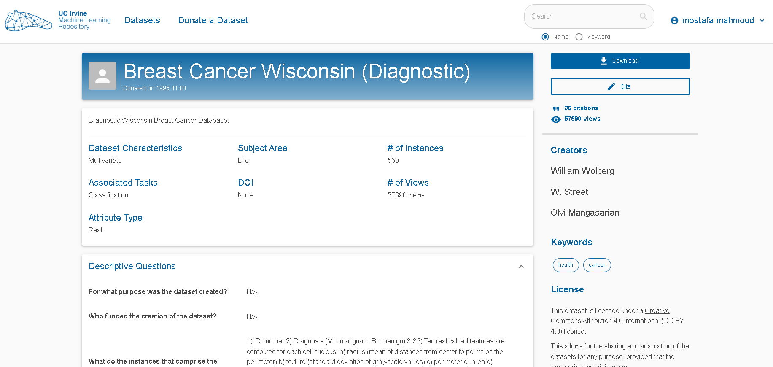
How to download data set

Slide 4
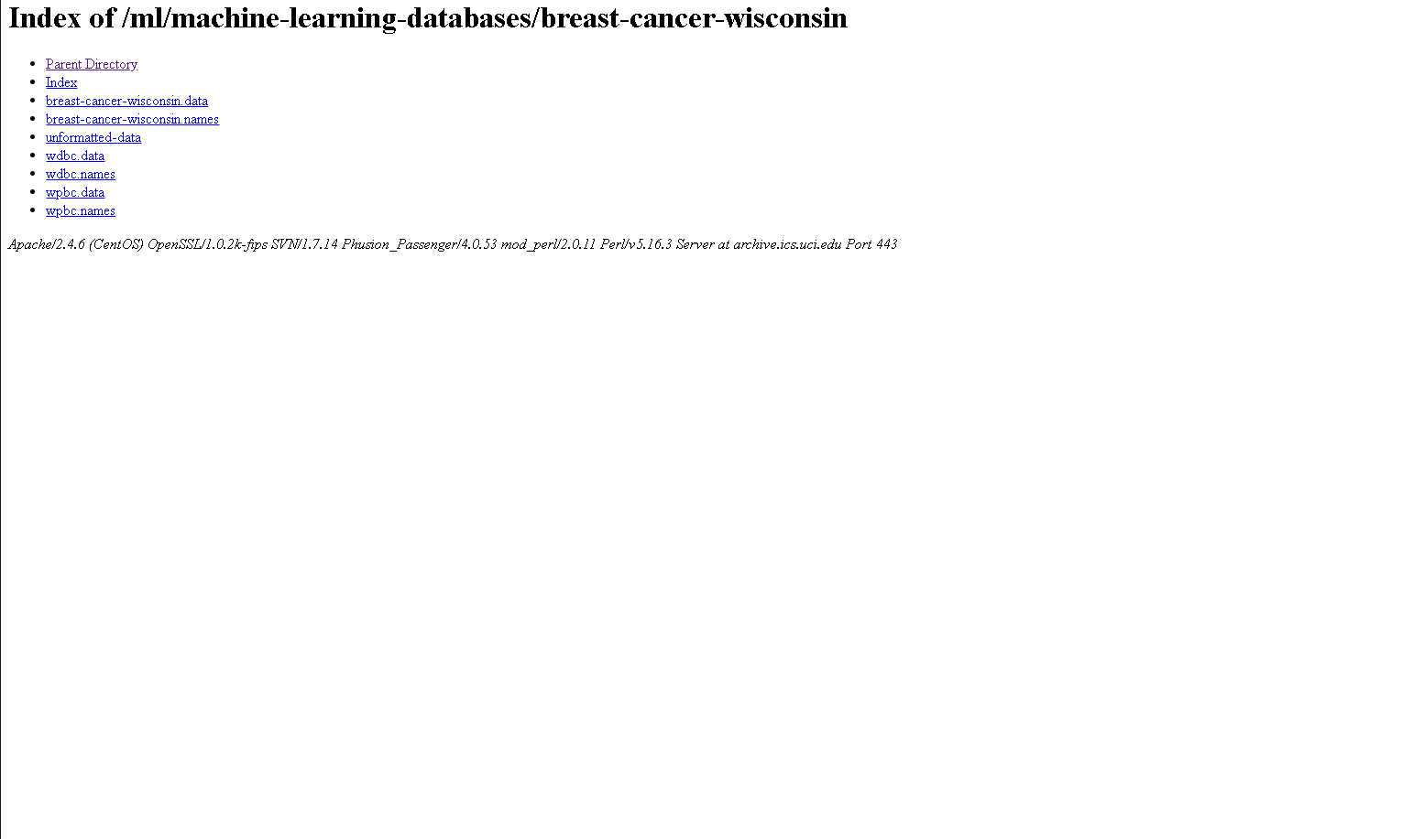
Download breast cancer .data and .names

Slide 5
To know which attributes contain missing values
Preparing Dataset

Slide 6
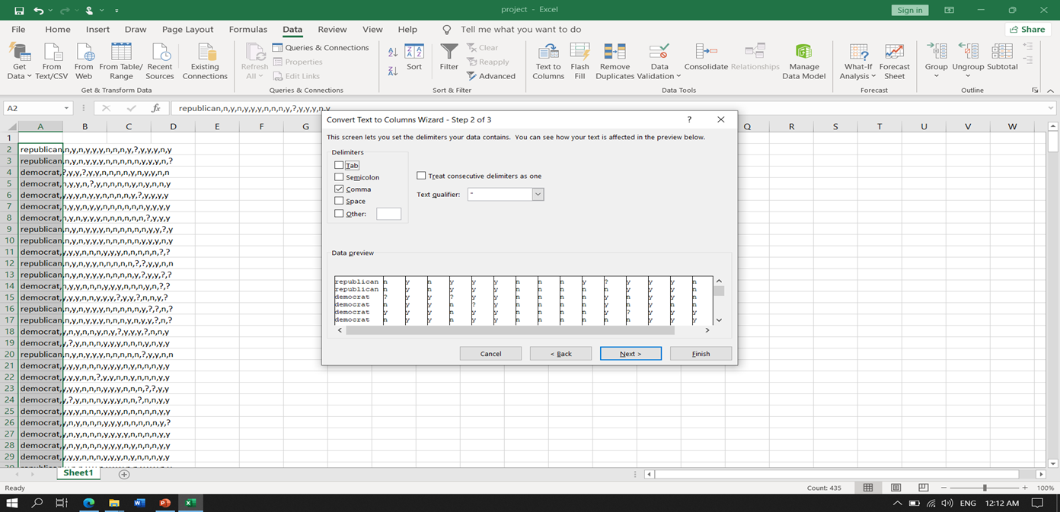
Preparing Dataset
Copy the dataset and past in Excel file.
To separate dataset in many columns rather than one column , do the following steps

Slide 7
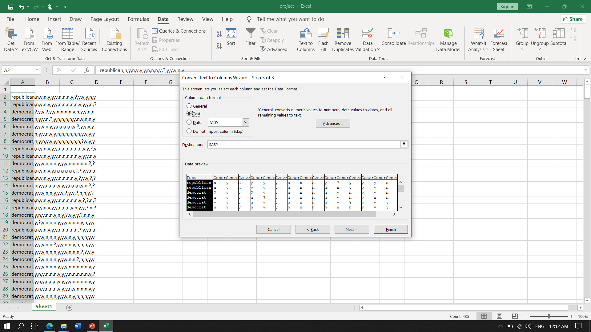
Preparing Dataset

Slide 8
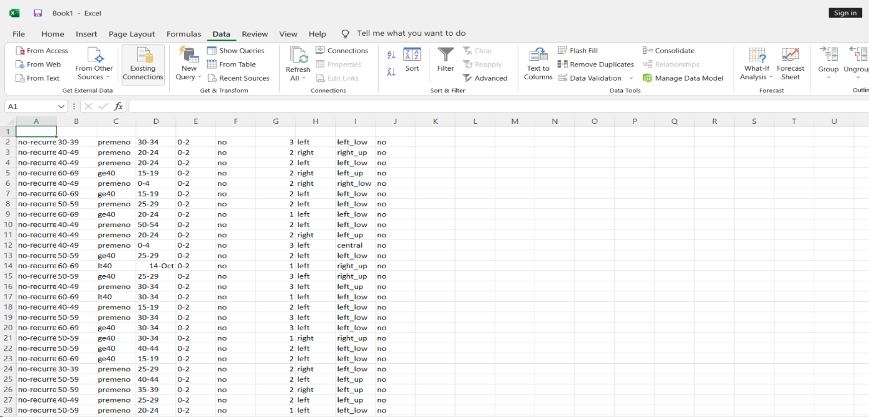
Preparing Dataset

Slide 9
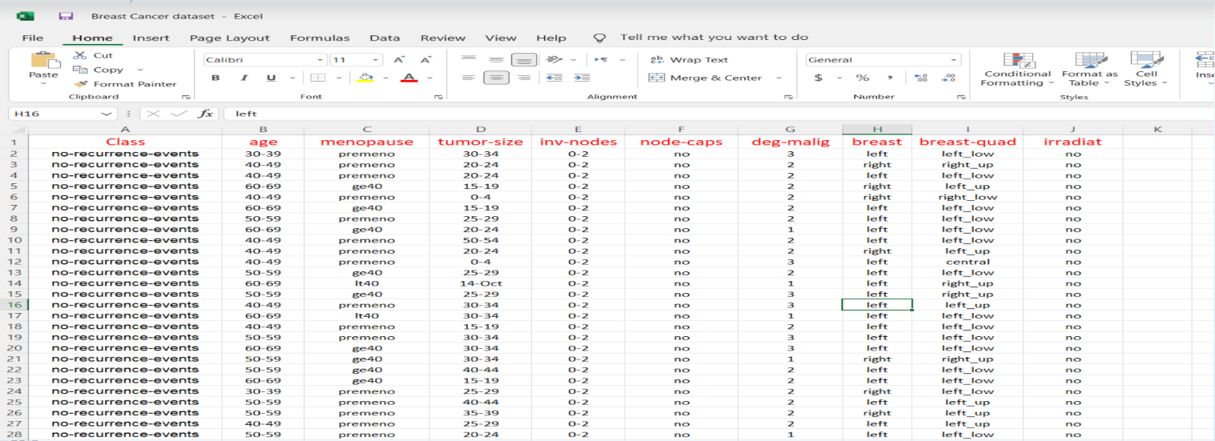
Preparing Dataset CONT…

Slide 10
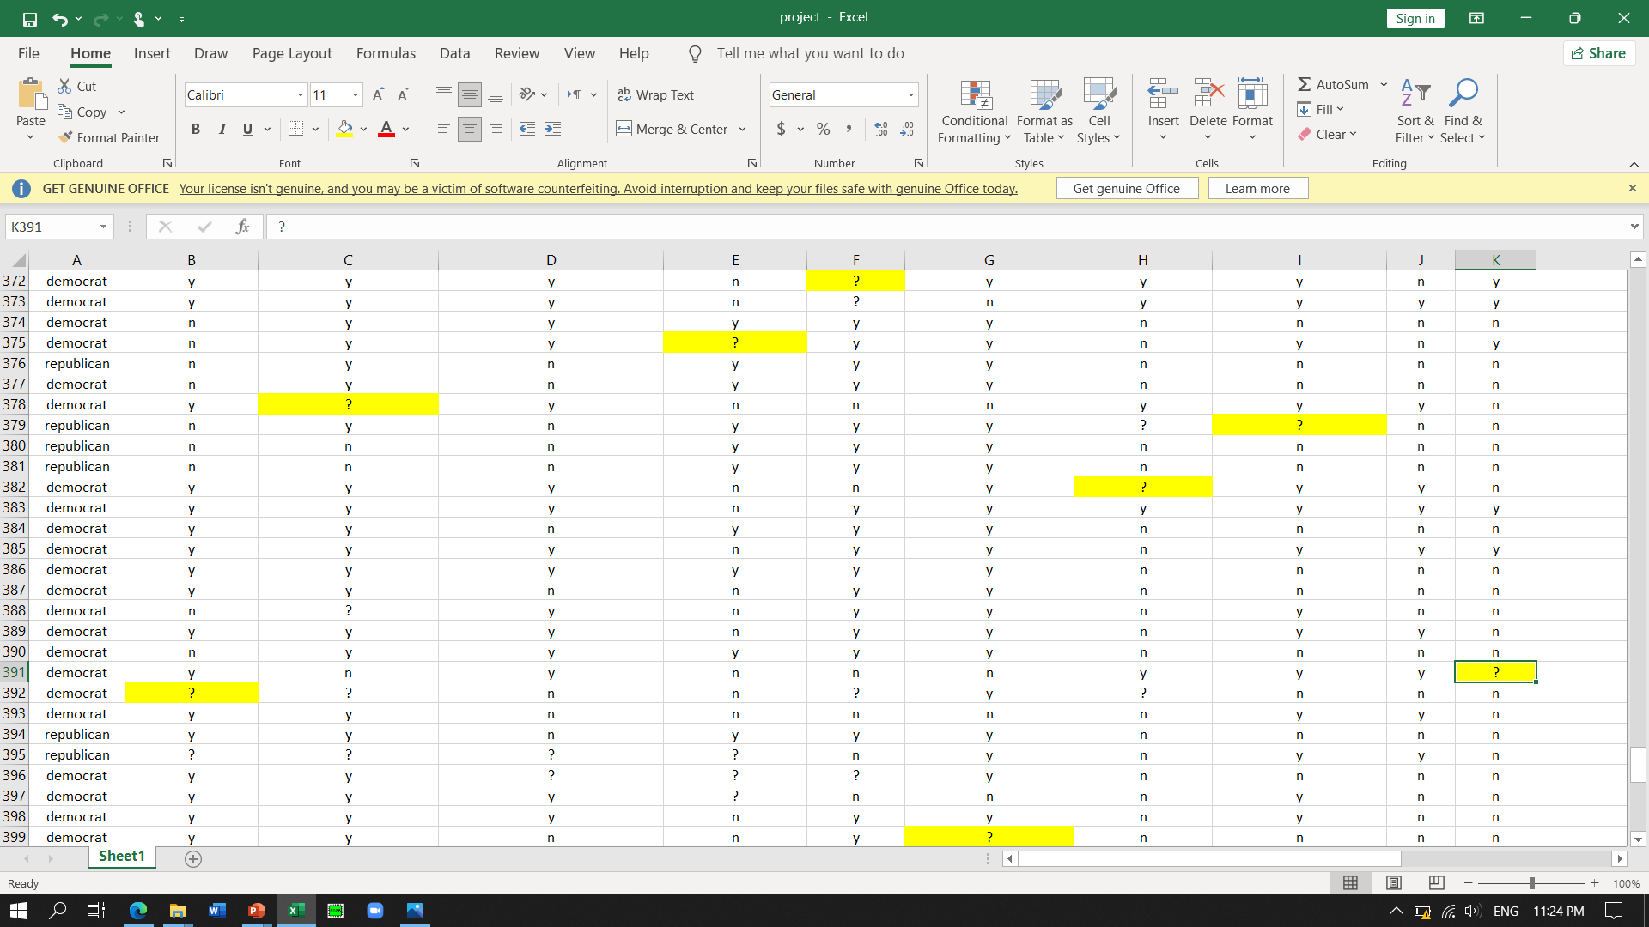
Missing Attribute values of Congressional Voting in Excel
Preparing Dataset

Slide 11
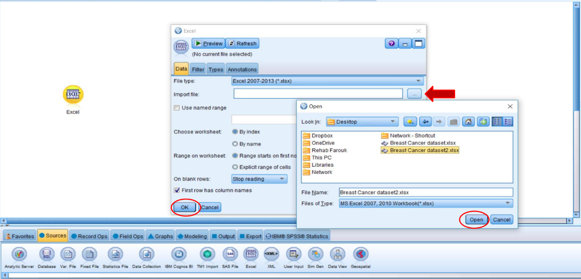
Handling Missing Values

Slide 12
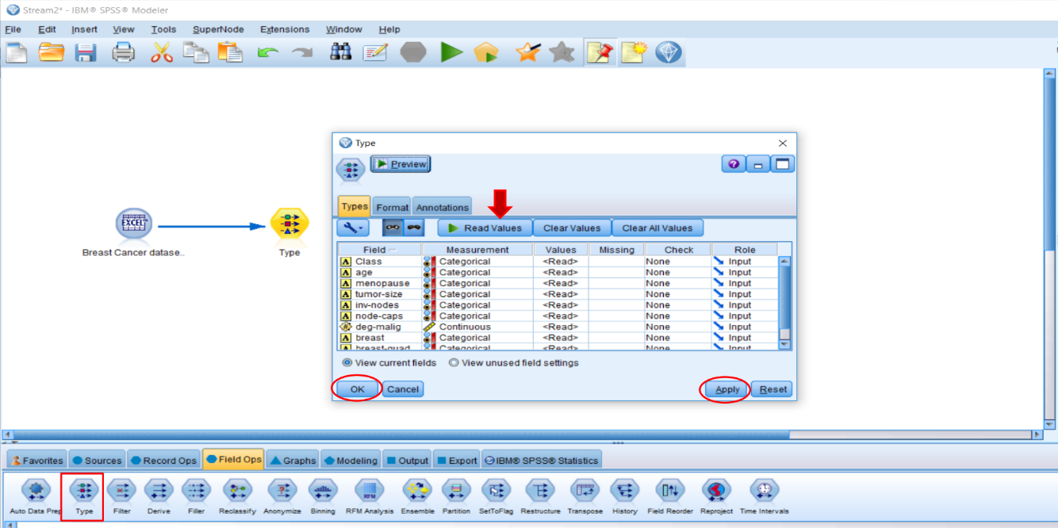
Handling Missing Values CONT…

Slide 13
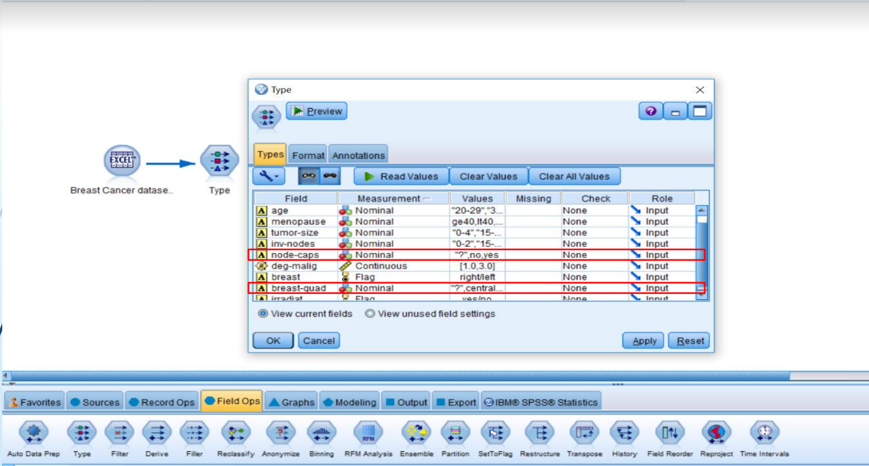
Handling Missing Values CONT…

Slide 14
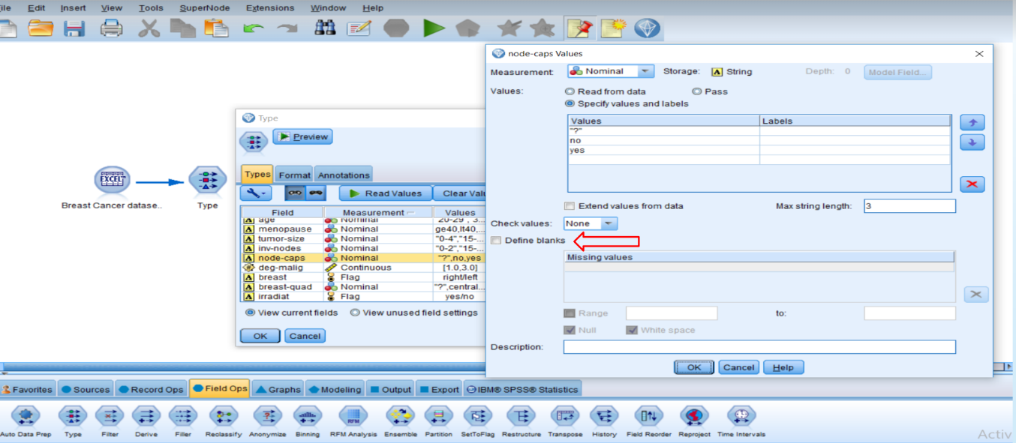
Handling Missing Values CONT…

Slide 15
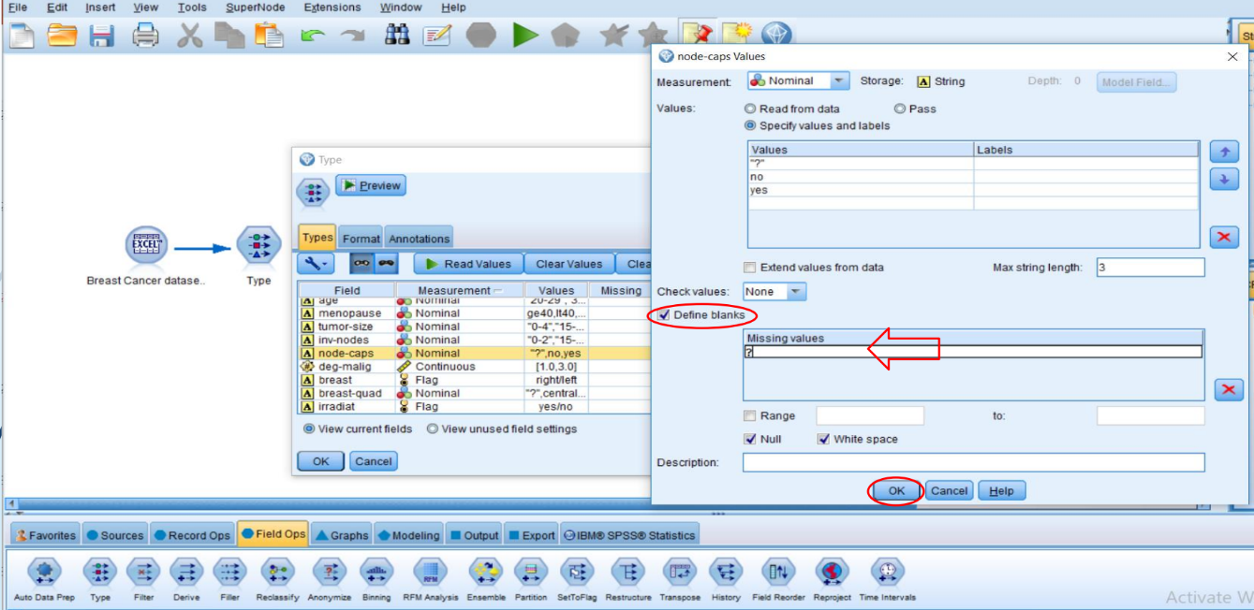
Handling Missing Values CONT…

Slide 16
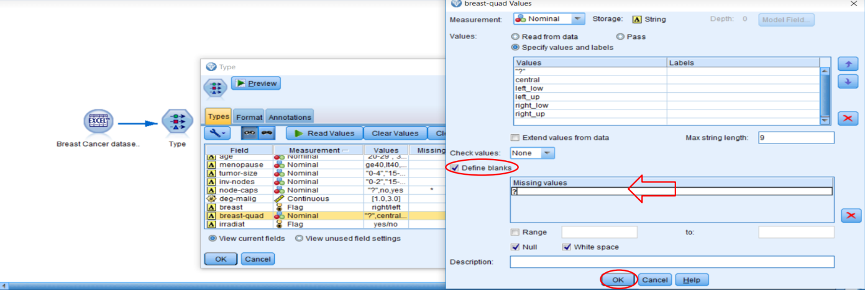
Handling Missing Values CONT…

Slide 17
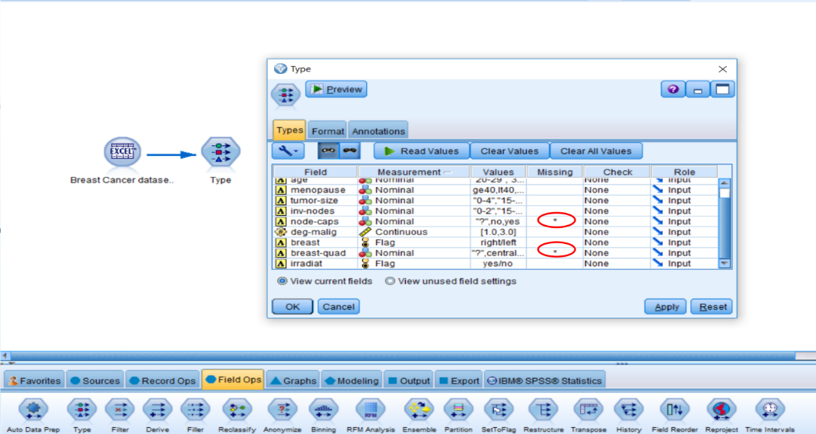
Handling Missing Values CONT…

Slide 18
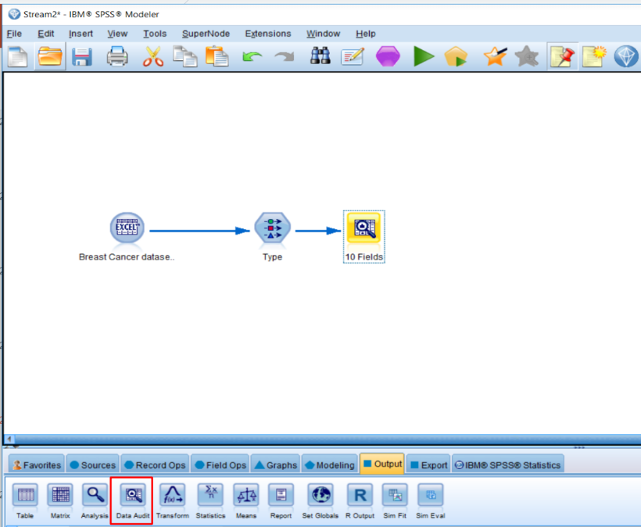
Handling Missing Values CONT…

Slide 19
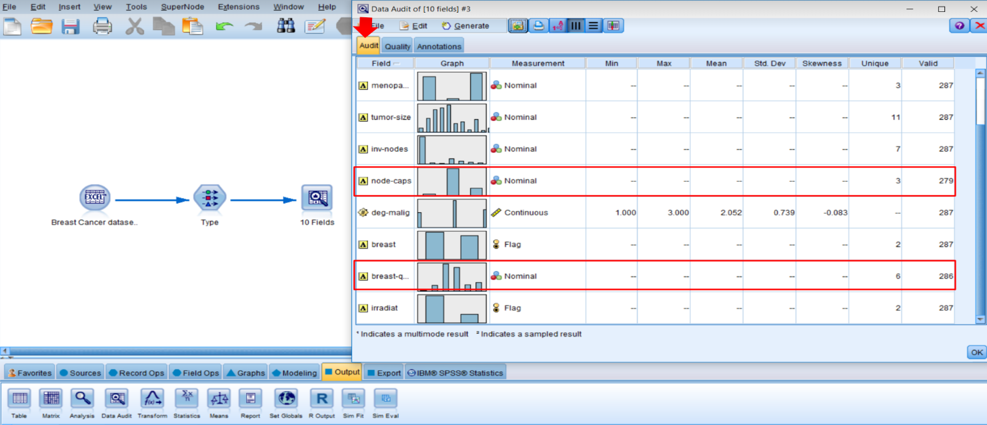
Handling Missing Values CONT…

Slide 20
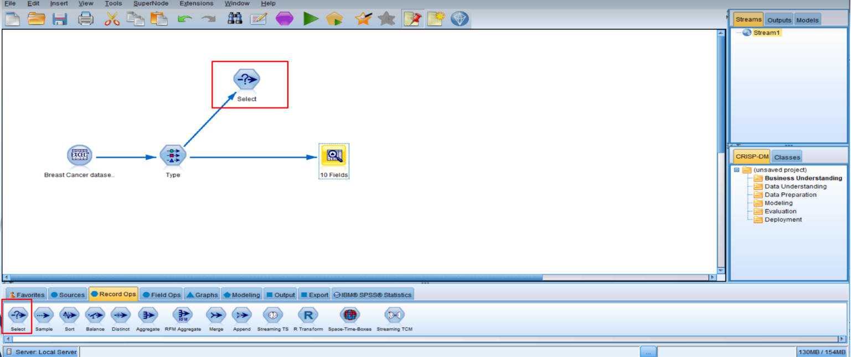
Handling Missing Values CONT…

Slide 21
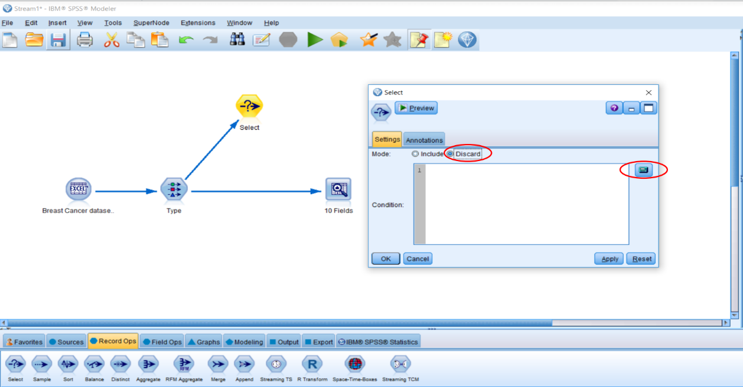
Handling Missing Values CONT…

Slide 22
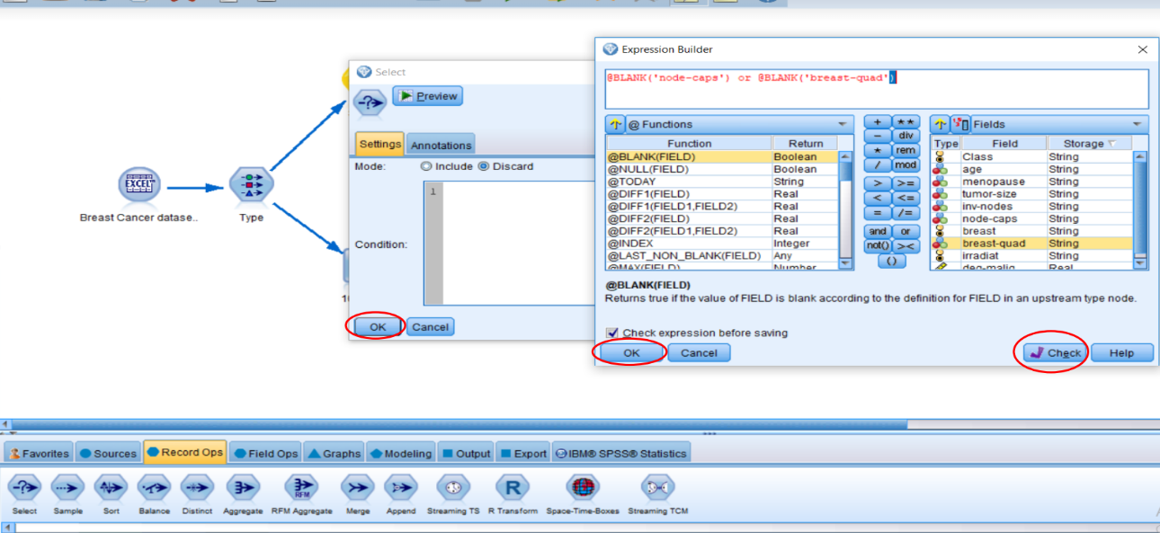
Handling Missing Values CONT…

Slide 23
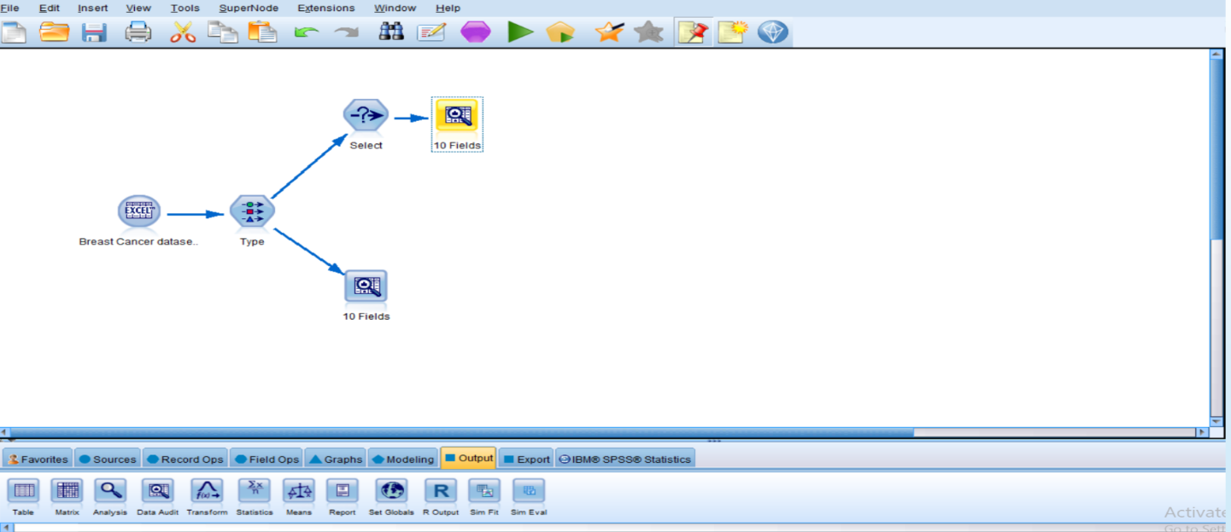
Handling Missing Values CONT…

Slide 24
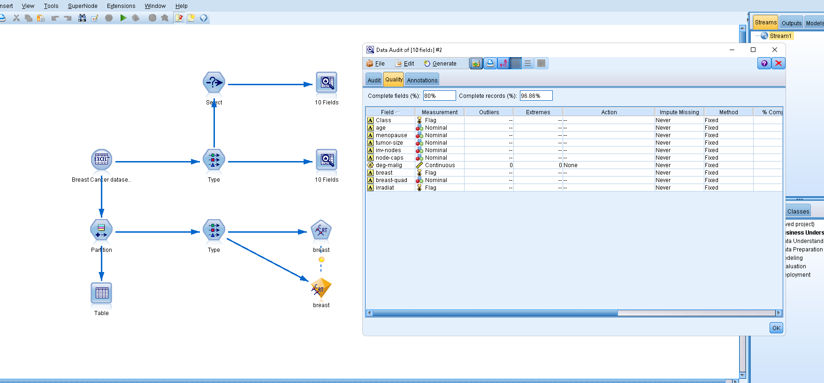
Output In data Audit

Slide 25
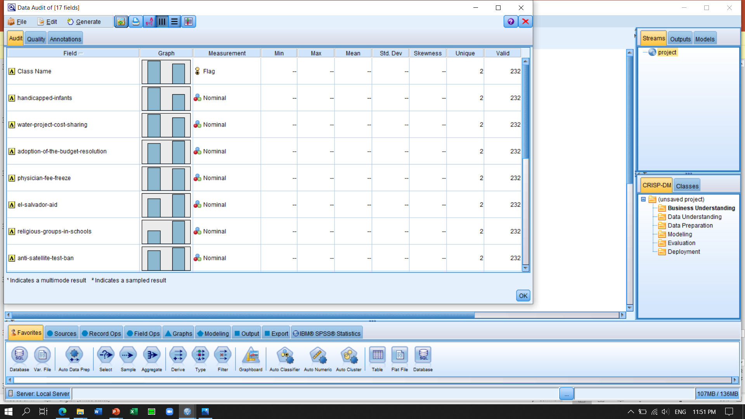
Handling missing values using IBM SPSS Modeler

Slide 26
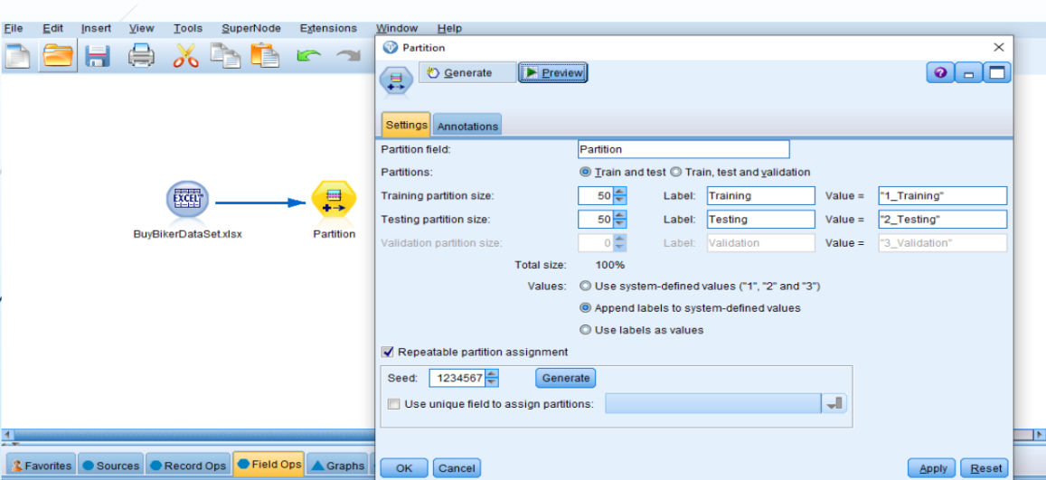
partition

Slide 27
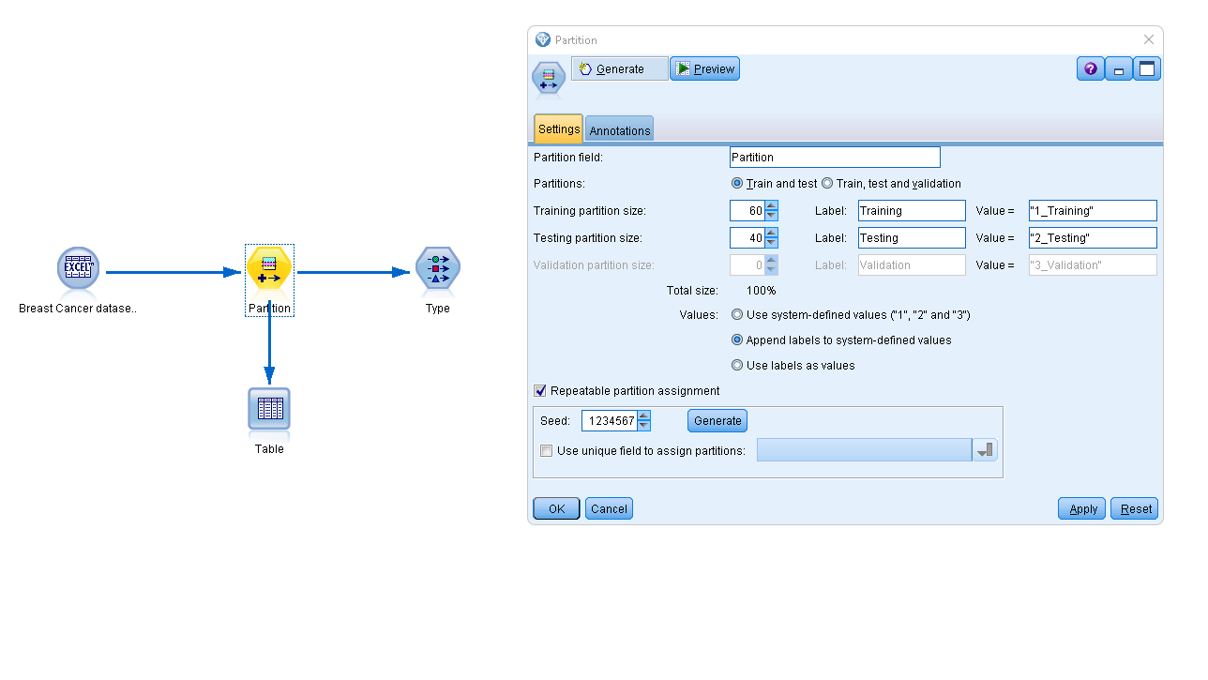
table

Slide 28
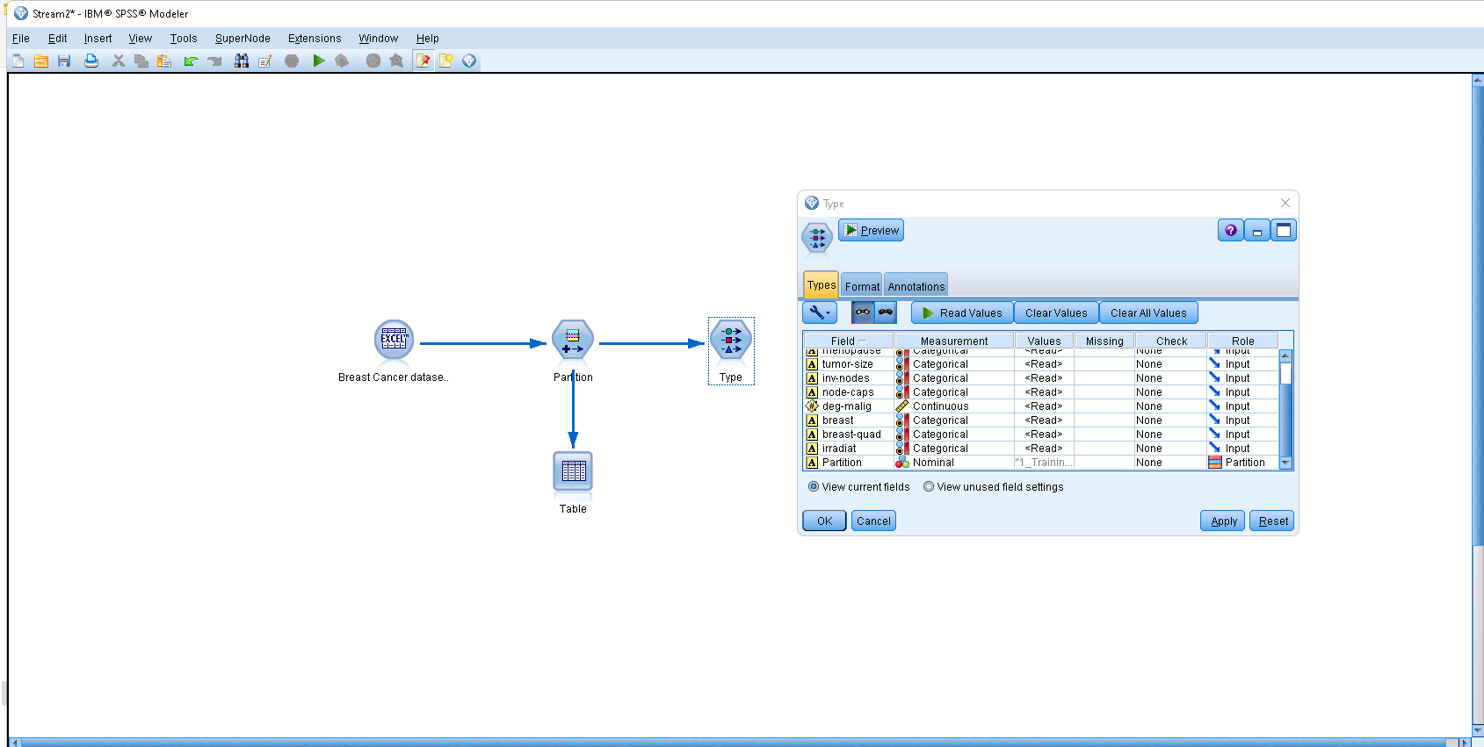
role

Slide 29
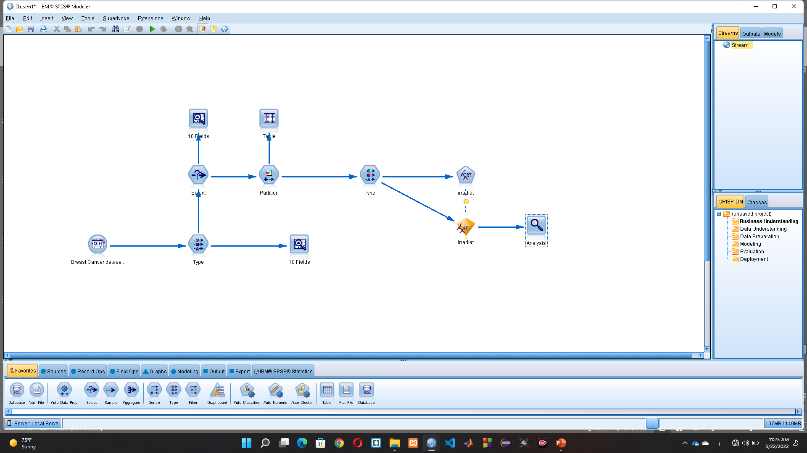
classification

Slide 30
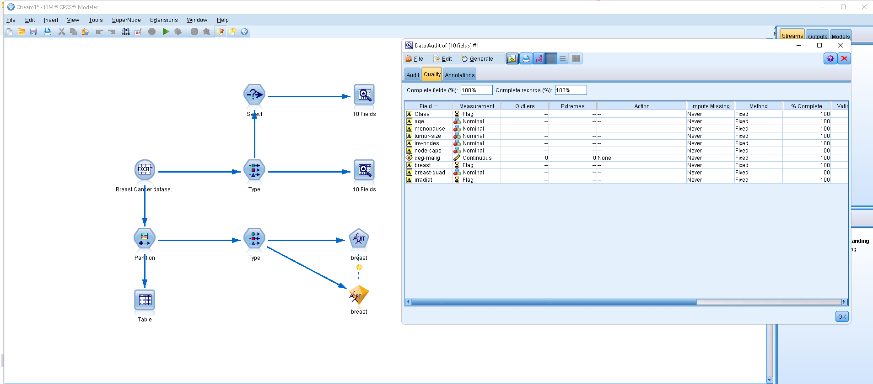

Slide 31
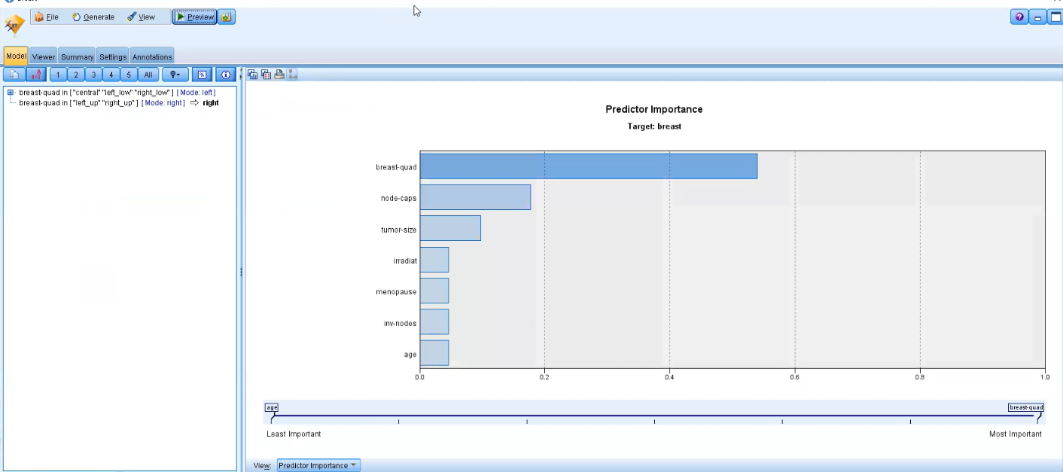
RUN

Slide 32
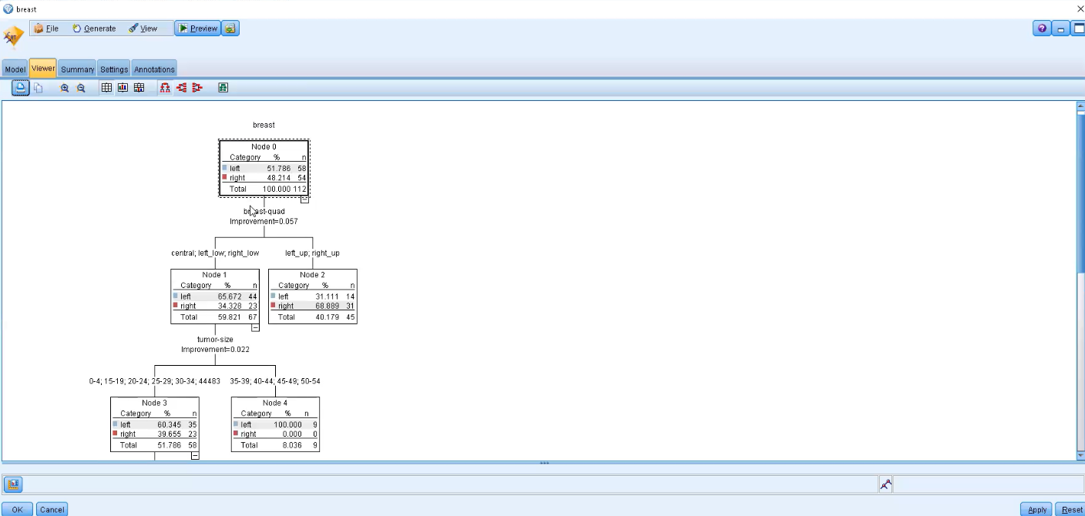
Decition Tree

Slide 33
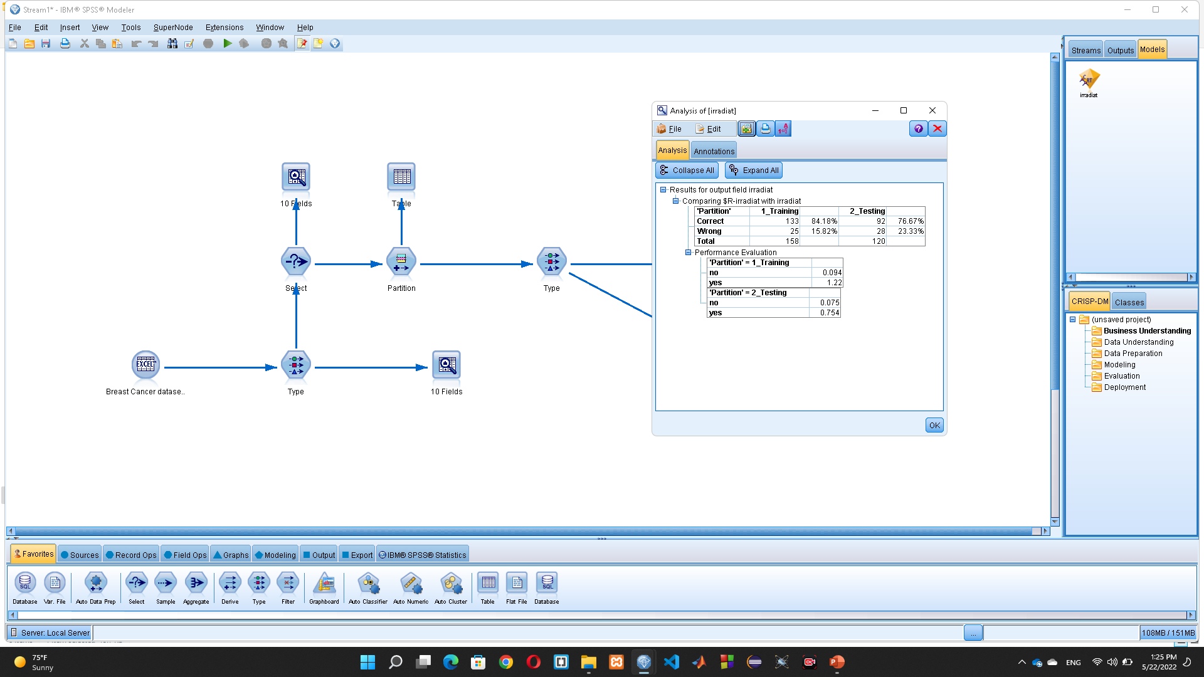
Convusion matrix

